Slide 1

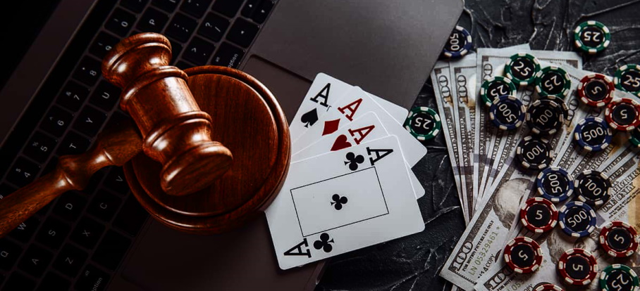
Full Stack Flush
Chineze Obi
Darian Hamel
Kaye Ruwe Mendoza
Mateo DeSousa
Prashant Nigam
Scott Barrett
Notes:
Darian’s slide

Slide 2
Our Vision
Our Goal
A gambling web application designed to set a new standard for gambling platforms through its integrated ethical features.
Vision Statement
We strive to improve gambling habits of the overall population.
Success Criteria
To see a steady increase in the percentage of users gambling with fake tokens and a decrease in real money being gambled.
Notes:
Mateo’s slide

Slide 3
Ethical Gambling?
64.5% of Canadians aged 15+ (18.9 million) reported gambling in the past year
1.6% of gamblers (304,400) at moderate-to-severe risk of gambling problems
A meta-analysis of 14 studies estimated that 37% of people with a gambling problem have perpetrated physical IPV (Dowling N. et al., 2016).
Gambling harm also occurs well below clinical thresholds. Signs of harm include the diversion of money from essential household spending. This can lead to food insecurity, housing problems and difficulties accessing healthcare and education.
Notes:
Kaye’s slide

Slide 4
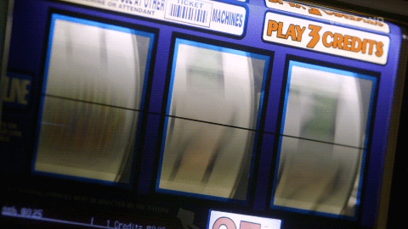
Core Features
Notes:
Darian’s slide

Slide 5
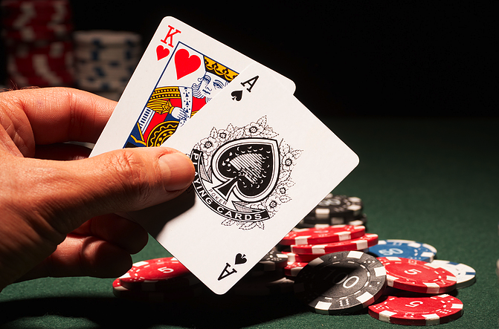
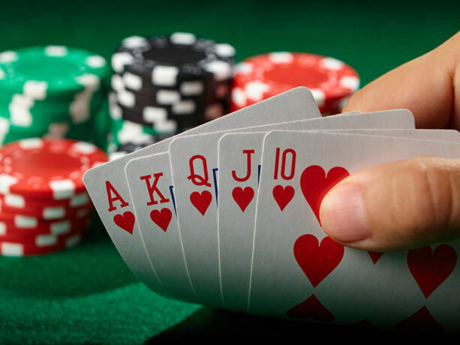
Card Games
Blackjack
Poker
Standard blackjack card game
Notifications for bet amounts
Poker-like minigame
Create the best poker hand (inspired by the game Balatro)
Non-functional feature: 50 concurrent users and 500 requests per minute
Notes:
Prash’s slide

Slide 6
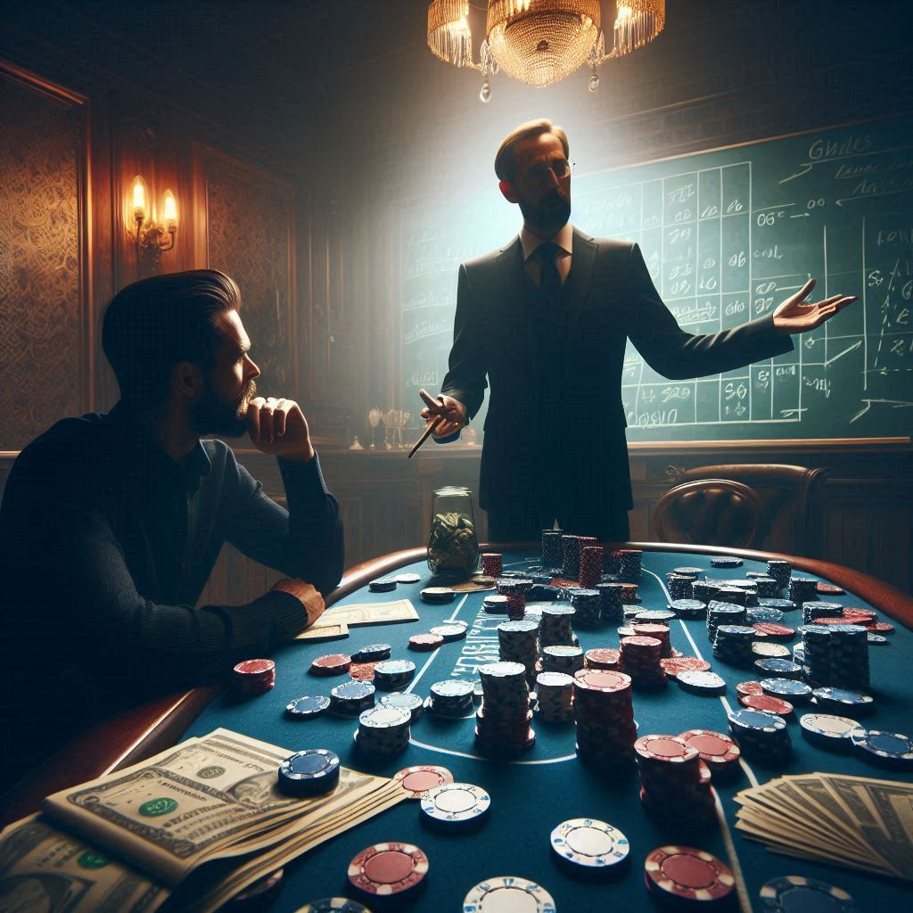
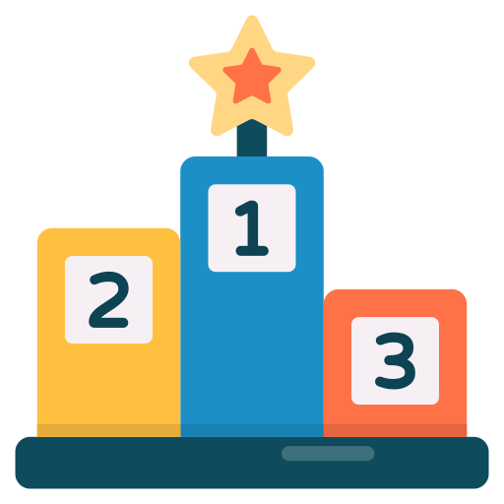
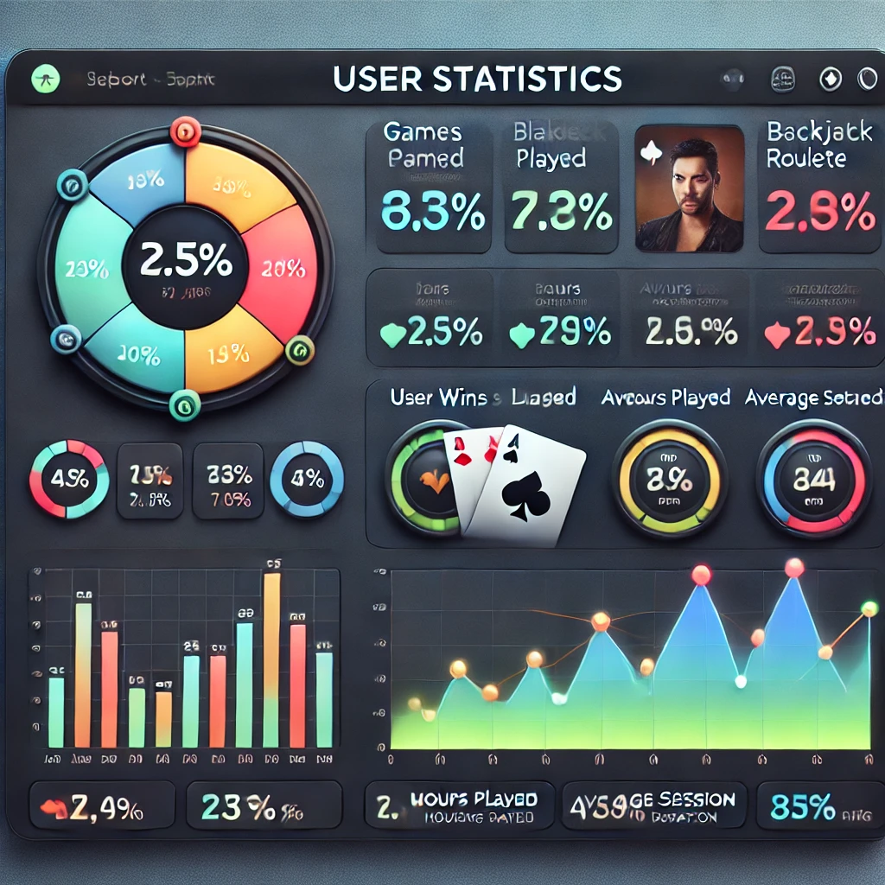
What makes it engaging?
Teaching Fundamentals
Leaderboards
User Stats
Teach users the basics of the games
Provide information on the odds of the games
A leaderboard that compares win/loss ratios against other users
Track win/loss ratio
Transaction history
Days and times visited
Notes:
Chineze’s slide

Slide 7

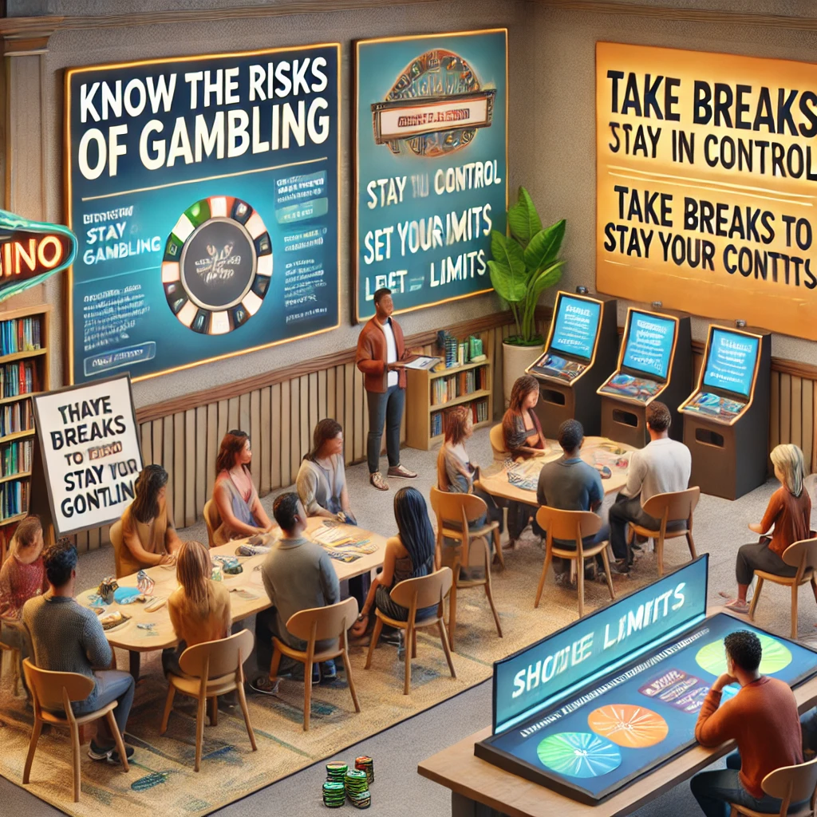
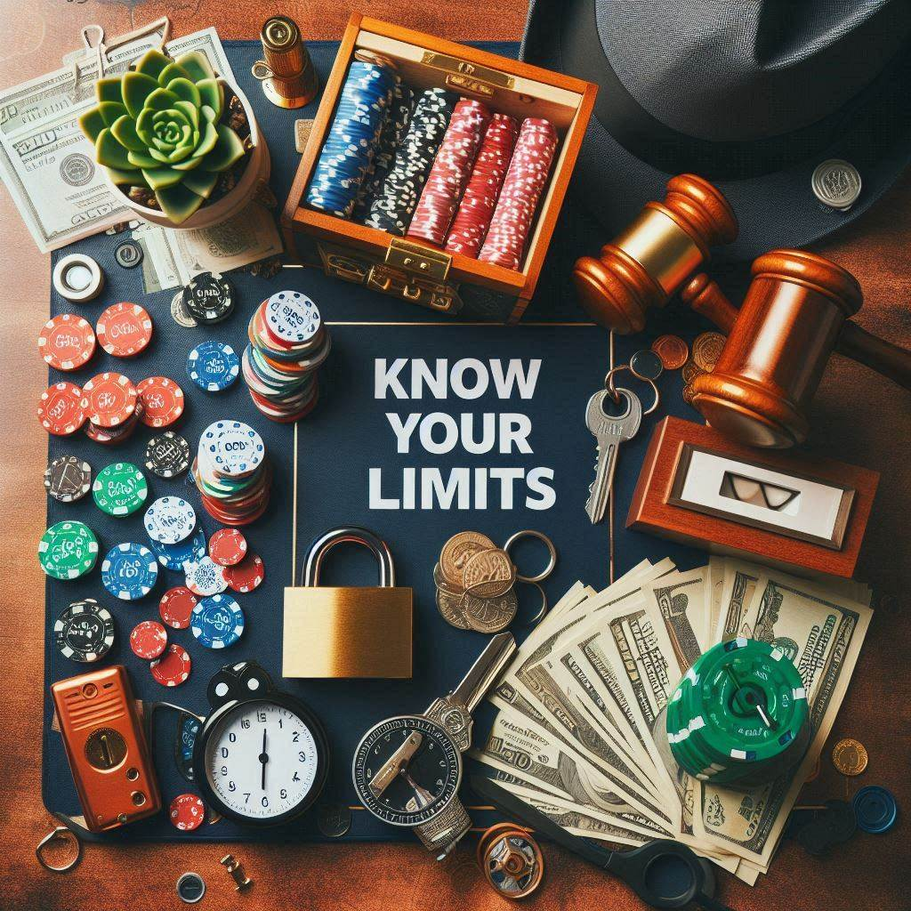
Safe Gambling
Remind users to take breaks
Provide warnings, reminders, and useful facts about the dangers of gambling
Educate users
Set time and money limits on gambling
Gambling habit tracking
Option to gamble with fake currency
Notes:
Scott’s slide

Slide 8
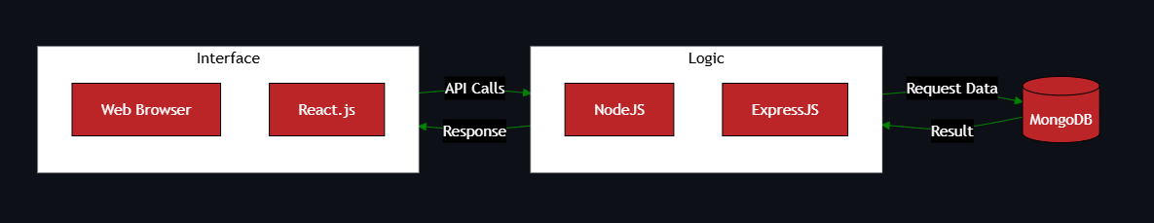
Technology – MERN Stack
Database: MongoDB
Back-end: Express.js and Node.js
Front-end: React.js
CI/CD: GitHub Actions
Notes:
Darian’s slide

Slide 9
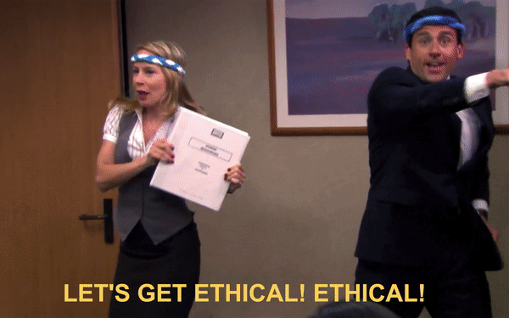
Thank you!

Slide 10
References
https://chatgpt.com/share/679695bc-01fc-800d-8eb5-43e02c3b8632
https://www.sigma-orionis.com/gambling-market/ethics-issues-related-to-gambling/
https://chatgpt.com/share/679695e1-faf4-8013-878b-af59d7175b91
https://sl.bing.net/cbfIrusfmay
https://sl.bing.net/eQehuvQgqI0
https://i.gifer.com/8nNh.gif
https://www.freepik.com/icon/leaderboard_11106449
https://crescent.edu/post/the-history-of-blackjack
https://www.gamezy.com/card-games/poker/
https://www150.statcan.gc.ca/n1/pub/75-006-x/2022001/article/00006-eng.htm
https://pmc.ncbi.nlm.nih.gov/articles/PMC9606773/#:~:text=A%20meta-analysis%20of%2014,their%20confidence%20intervals%20vary%20widely
https://www.who.int/news-room/fact-sheets/detail/gambling

